Slide 1
UNCERTAINTY QUANTIFICATION OF AGENT-BASED MODELS WITH APPLICATION TO MALARIA INTERVENTION MODELING
PhD Update
February 2025

Slide 2
Aim
To quantify and propagate the uncertainty from various parameters in the OpenMalaria Ghana model, beyond just the entomological inoculation rate (EIR) and to determine the impact of these uncertainties on simulating the effect of malaria interventions at the sub-national level.

Slide 3
Uncertainty Quantification can be classified in two forms
The field of Uncertainty Quantification offers a means of quantifying and characterizing uncertainties in models and the real world.
Forward Propagation of Uncertainty
Investigates the impacts of random input values of model parameters on model outputs
Inverse Uncertainty Quantification
using experimental data to learn about the sources of modeling uncertainty
Sensitivity Analysis
Model Calibration

Slide 4
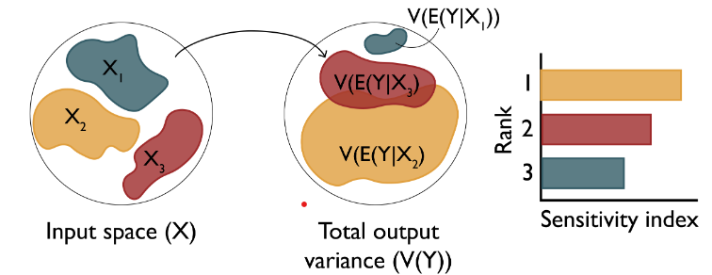
Research Objectives
Objective 1: Understand the key drivers of impact of malaria interventions in Ghana
Objective 3: Simulate the impact of malaria interventions in Ghana in order to support decisions for strategic planning
Objective 2: Develop a novel inference framework for calibrating the OpenMalaria model at a higher spatial resolution
Perform sensitivity analysis of coverage, halflife of efficacy and vector composition towards prevalence reduction and clinical cases averted (Forward Propagation of uncertainty)
Source: Sensitivity Analysis: The Basics

Slide 5
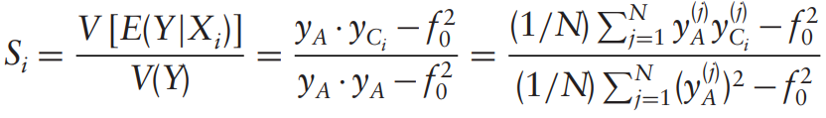
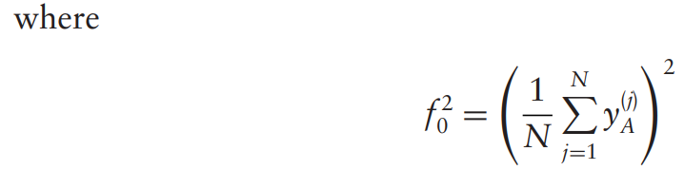
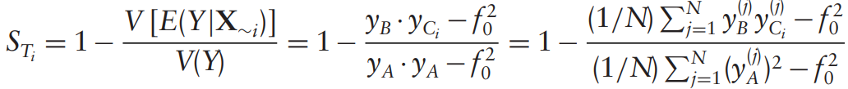
Variance-based sensitivity analysis (Sobol)

Slide 6
Objective 1 – Modifying the existing workflow
Chose a sampling scheme to reduce number of OM simulations and runtime
How do we reduce the number of OM simulations in order to drastically reduce runtime?
Tried other sampling designs instead of sweeps
Trained GP model on EIR, intervention coverages, prevalence reduction and used model for prediction while performing sensitivity analysis
Choose a sensitivity method (compared soboljansen and sobolsalt)
Notes:
To address uncertainties, we identify and quantify the various sources of uncertainty in intervention modeling

Slide 7
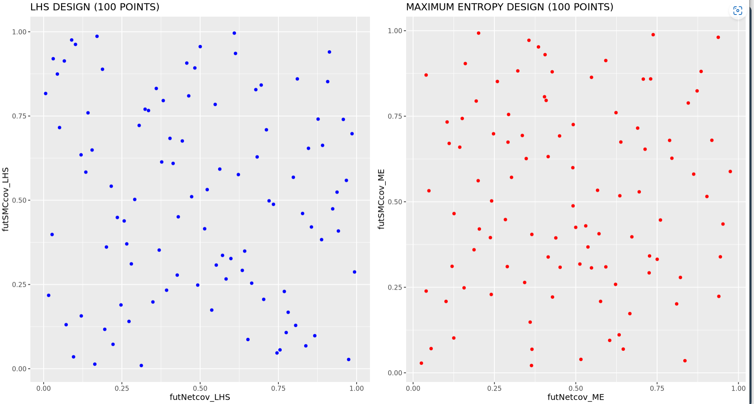
1 – LHS vs MED SAMPLING (100 POINTS)
LHS or ME sampling during simulation setup cuts runtime drastically

Slide 8
1 – LHS or ME sampling during simulation setup cuts runtime drastically
SETTING | NUMBER OF SIMULATIONS REQUIRED (SWEEPS) | NUMBER OF SIMULATIONS REQUIRED (LHS) | R-SQUARED | NUMBER OF X_COLS | GP TRAINING TIME (mins)
UPPER.EAST4 | 50K (submitted) | 1500 | 0.97 (sweep) | 4 | 11.9
OTI | 300000 (not submitted) | 2500 | 0.96 (LHS) | 4 | 1.9
BONO.EAST (no_LSM) | 212500 (not submitted) | 2000 | 0.95 (LHS) | 4 | 1.4
Notes:
LLINs is the most influential in determining the output variance

Slide 9
2 – GP performance evaluation - learning of prevalence reduction gives good statistical correspondence Actual vs predict for 3 settings: full EIR sweep for UE and LHS for Oti and BE
The GP was trained using all simulation data
Model performance was evaluated using R-sqaured
Notes:
LLINs is the most influential in determining the output variance

Slide 10
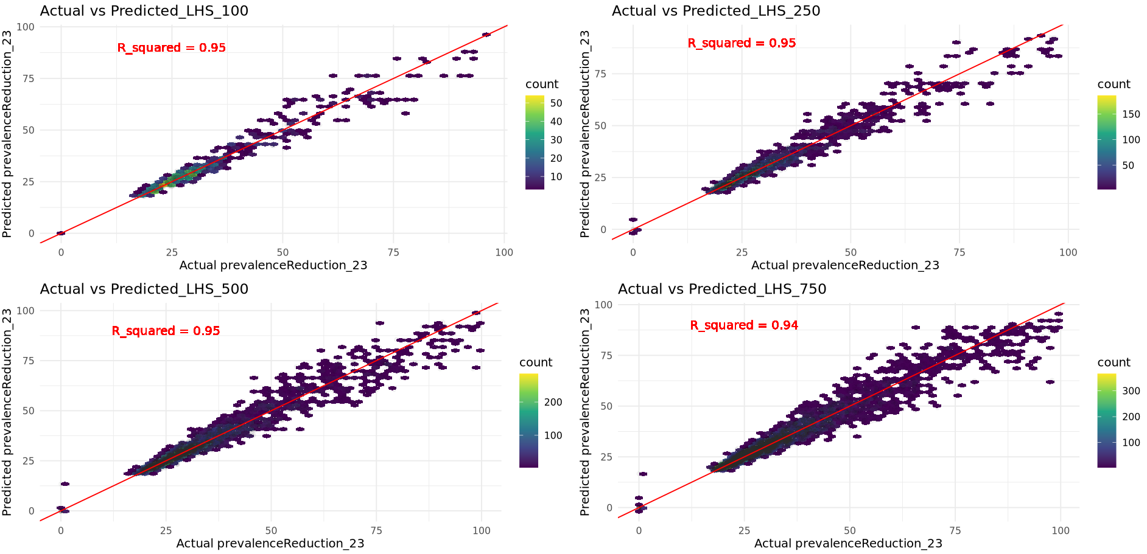
2 – GP performance evaluation - learning of prevalence reduction gives good statistical correspondence Actual vs predict using different LHS sample sizes for UE4
The GP was trained using all simulation data
Model performance was evaluated using R-sqaured
Notes:
LLINs is the most influential in determining the output variance

Slide 11
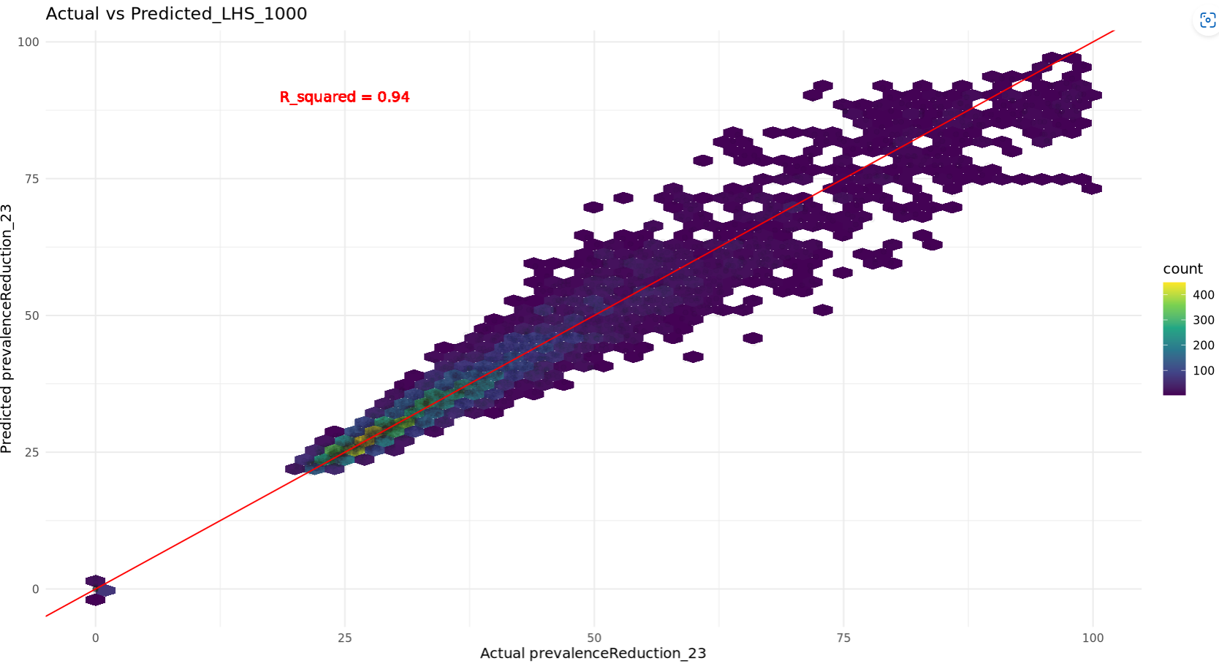
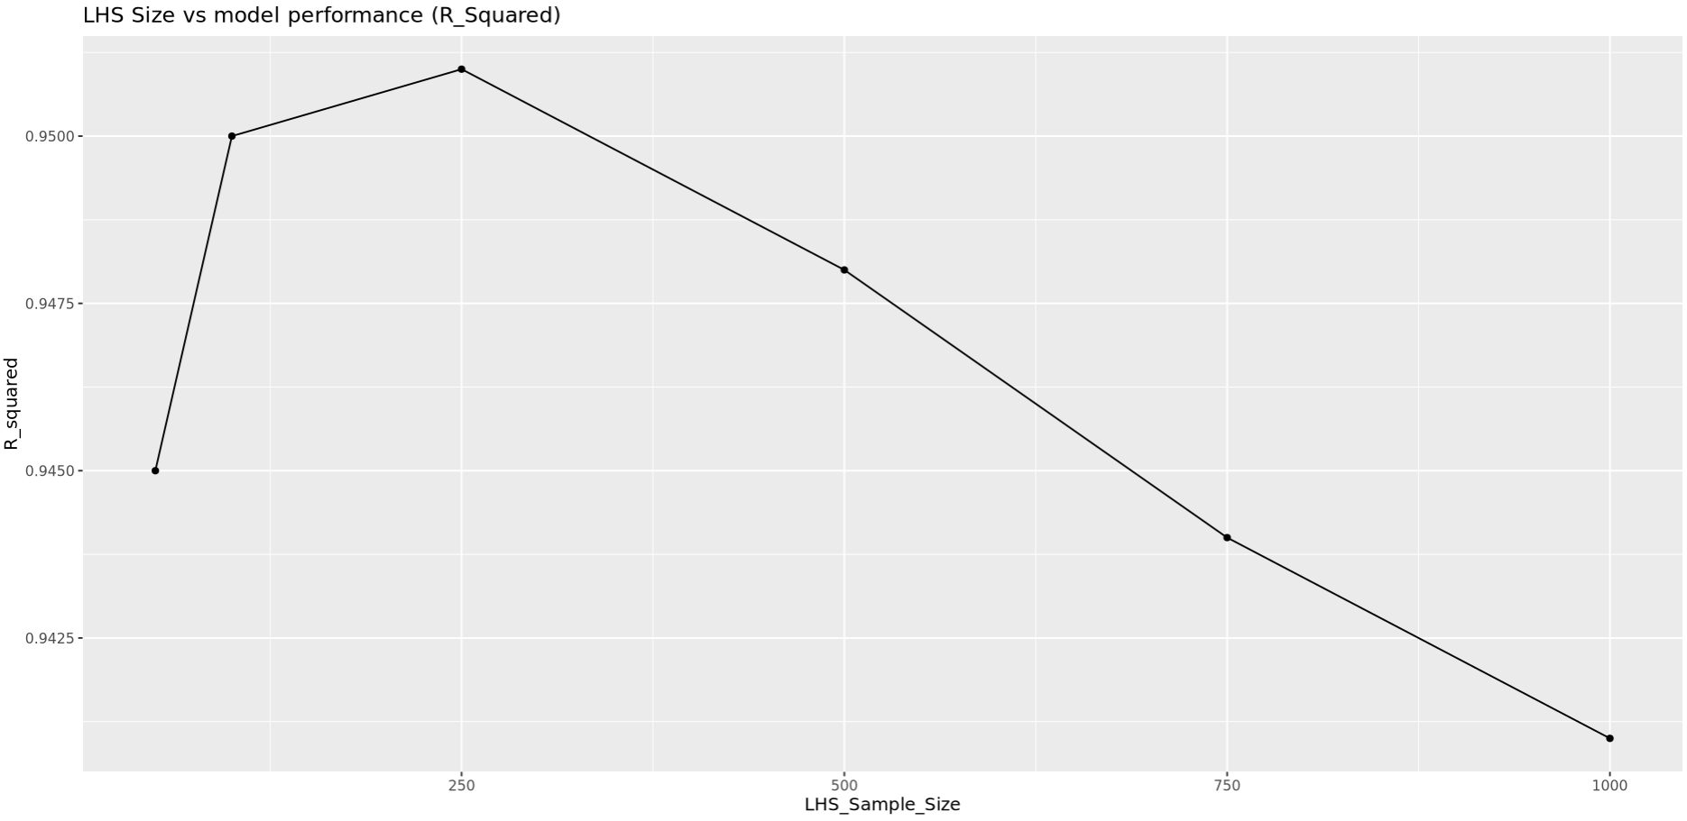
2 – GP performance evaluation - learning of prevalence reduction gives good statistical correspondence Actual vs predict using different LHS sample sizes for UE4
Notes:
LLINs is the most influential in determining the output variance

Slide 12
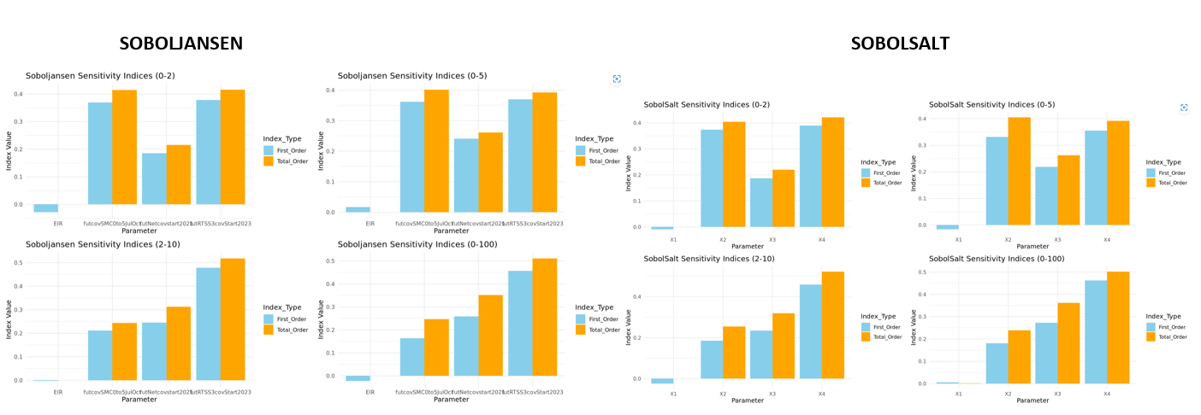
3 - Sobol methods comparison
Sobol sensitivity analysis of future coverages of malaria interventions for 3 settings in ghana: upper.EAST4, OTI and BONO.East.
Notes:
LLINs is the most influential in determining the output variance

Slide 13
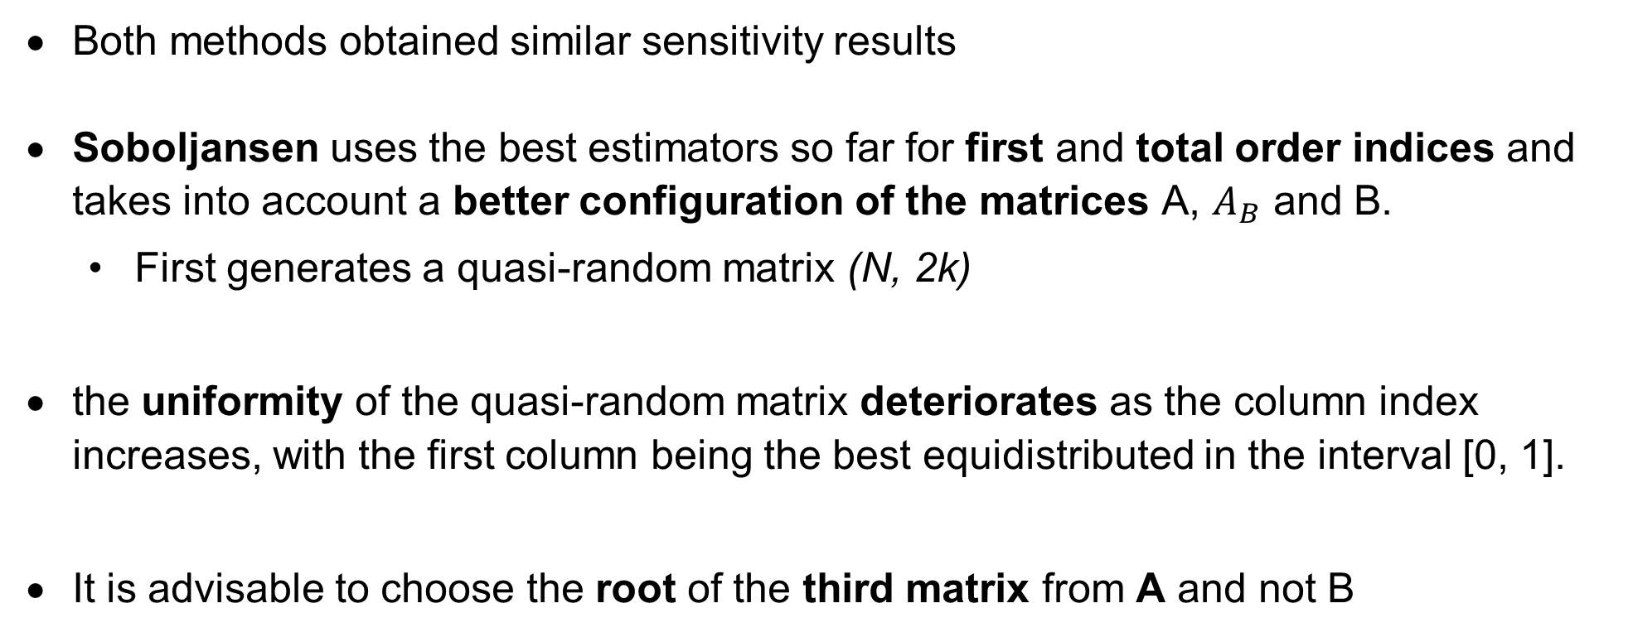
3 - Sobol methods comparison
Both methods obtained similar sensitivity results
Soboljansen uses the best estimators so far for first and total order indices and takes into account a better configuration of the matrices A, $A_{B}$ and B.
First generates a quasi-random matrix (N, 2k)
the uniformity of the quasi-random matrix deteriorates as the column index increases, with the first column being the best equidistributed in the interval [0, 1].
It is advisable to choose the root of the third matrix from A and not B
Model performance was evaluated using R-sqaured
Notes:
LLINs is the most influential in determining the output variance

Slide 14
Current setup for OM simulations and Sobol sensitivity analysis with setting-specific EIR ranges and realistic intervention coverage ranges
Sample size of LHS = 250 instead of 100
Include IRS and CM
Train a GP model for each setting for 0-5 age_group, using EIR full range from OM outputs + deployed intervention coverage ranges
Setting specific EIR will use min EIR_lci and EIR_uci values across sub as param ranges
Sobol Sensitivity analysis uses setting-specific EIR + realistic intervention coverage ranges of interventions to be deployed
Non-deployed interventions are indicated as NA on the plot
Parameter ranges:
futcovSMC0to5JulOct_min = 0.4, futcovSMC0to5JulOct_max = 0.9,
futRTSS3covStart2023_min = 0.5, futRTSS3covStart2023_max = 0.9,
futNetcovstart2021_min = 0.2, futNetcovstart2021_max = 0.8
Notes:
LLINs is the most influential in determining the output variance

Slide 15
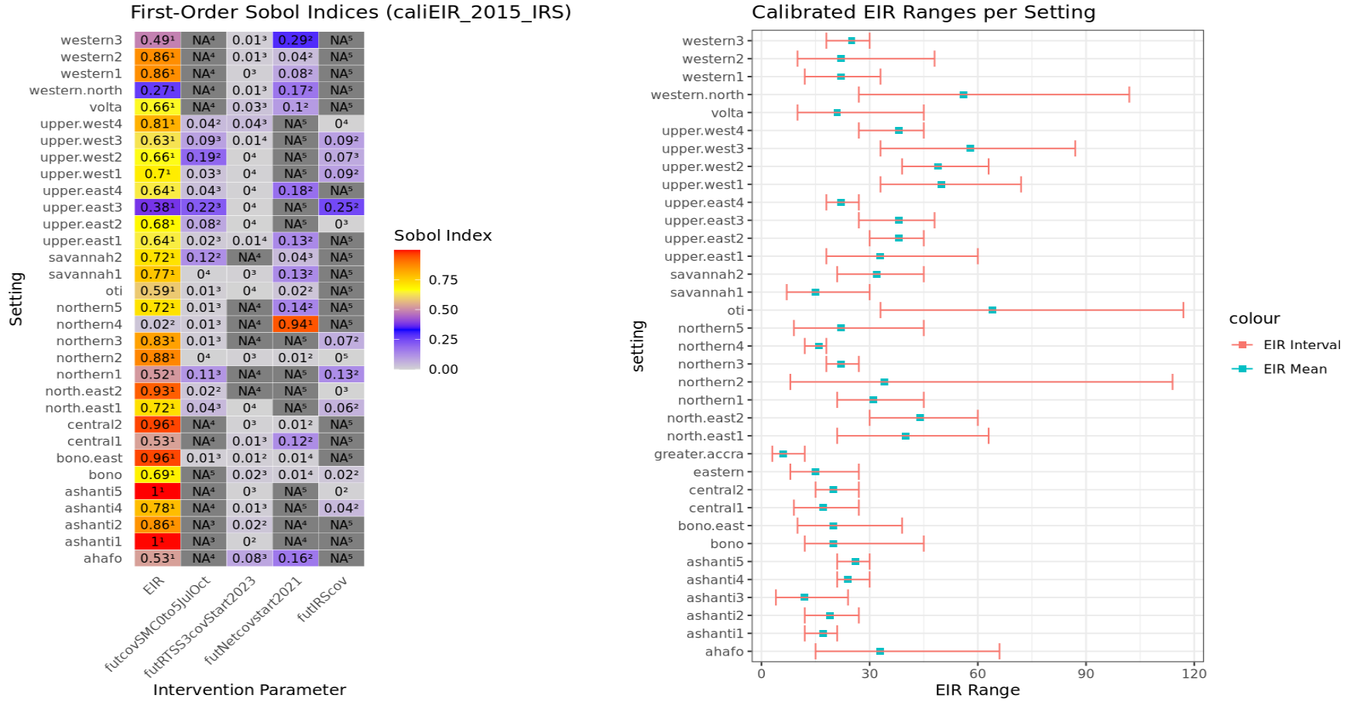
Sobol indices for 35 settings after integrating the above findings in the existing workflow
Notes:
LLINs is the most influential in determining the output variance

